Slide 1
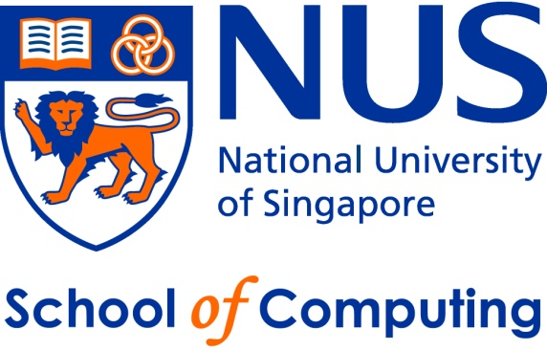
IT5002
Computer Systems and Applications
Lecture 11
Introduction to Operating Systems
colintan@nus.edu.sg

Slide 2
Learning Objectives
By the end of this lecture you should be able to:
  Describe the onion model.
  Understand the interaction between layers of the onion model.
  Describe the options for programming I/O.
  Give an overview of the key issues in OS design.

Slide 3
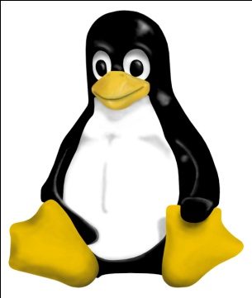
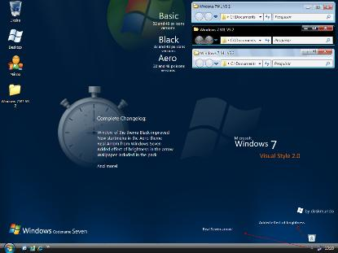
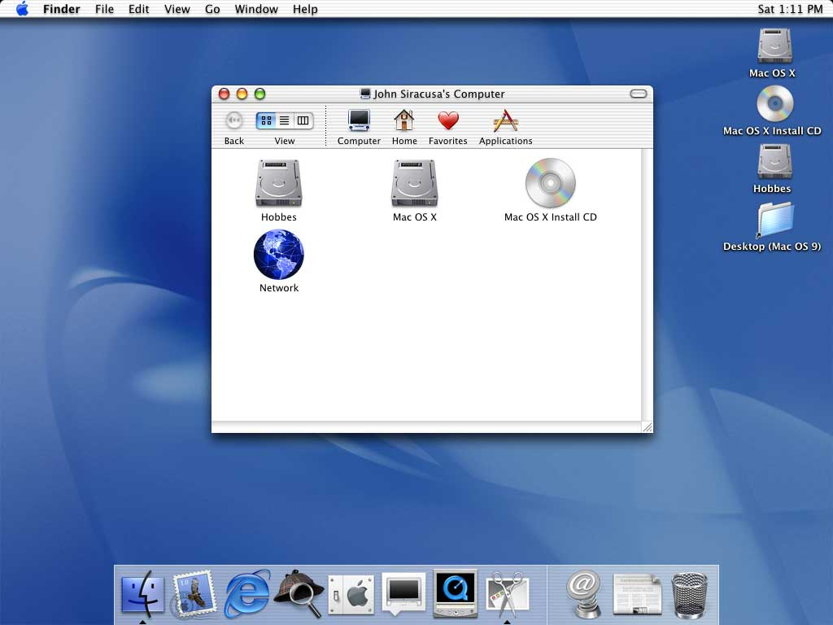
What are Operating Systems?
An “operating system” is a suite (i.e. a collection) of specialized software that:
  Gives you access to the hardware devices like disk drives, printers, keyboards and monitors.
  Controls and allocate system resources like memory and processor time.
  Gives you the tools to customize your and tune your system.
Examples include LINUX, OS X (a variant of UNIX), Windows 8.

Slide 4
What Are Operating Systems?
Usually consists of several parts:
  Bootloader – First program run by the system on start-up. Loads remainder of the OS kernel.
    On Wintel systems this is found in the Master Boot Record (MBR) on the hard disk.
  Kernel – The part of the OS that runs almost continuously.
    The bulk of this course is about how the kernel works.
  System Programs – Programs provided by the OS to allow:
    Access to programs.
    Configuration of the OS.
    System maintenance, etc.

Slide 5
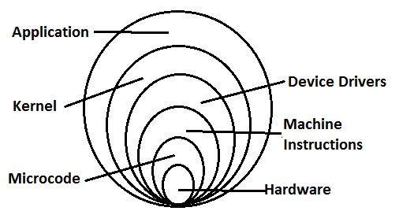
Basic Terminology:
The Onion Model.

Slide 6
Monolithic Kernels
Kernels can be monolithic or microkernel.
Monolithic kernels:
  All major parts of the OS – devices drivers, file systems, IPC, etc, running in “kernel space”.
    “Kernel space” generally means an elevated execution mode where certain privileged operations are allowed.
  Bits and pieces of the kernel can be loaded and unloaded at runtime (e.g. using “modprobe” in Linux)
  Popular examples of monolithic kernels: Linux, MS Windows.

Slide 7
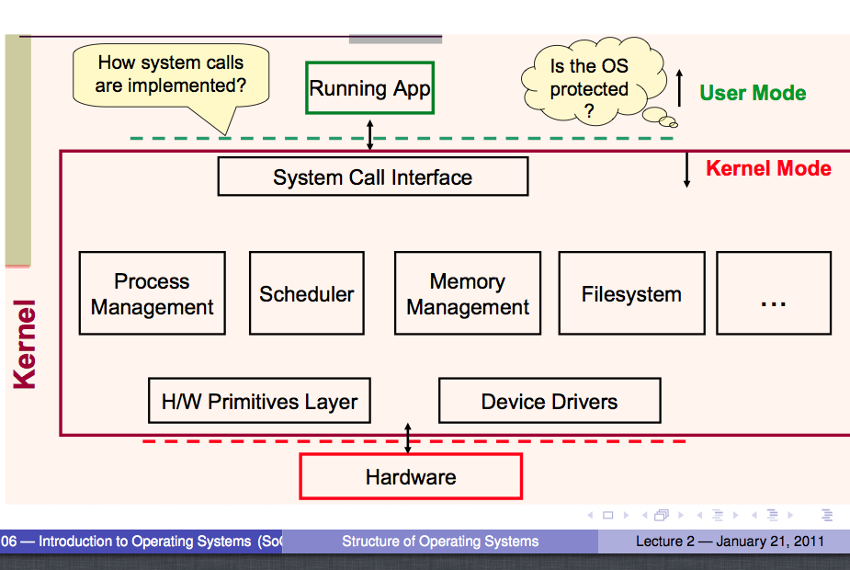
Monolithic Kernels

Slide 8
Microkernels
In modular kernels:
  Only the “main” part of the kernel is in “kernel space”:
Contains the important stuff like the scheduler, process management, memory management, etc.
  The other parts of the kernel operate in “user space” as system services:
    The file systems.
    USB device drivers.
    Other device drivers.
Most famous microkernel OS: MacOS.

Slide 9
External View of an OS
The kernel itself is not very useful.
  Provides key functionality, but need a way to access all this functionality.
We need other components:
  System libraries (e.g. stdio, unistd, etc.)
  System services (creat, read, write, ioctl, sbrk, etc.)
  OS Configuration (task manager, setup, etc.)
  System programs (Xcode, vim, etc.)
  Shells (bash, X-Win, Windows GUI, etc.)
  Admin tools (User management, disk optimization, etc.)
  User applications (Word, Chrome, etc).

Slide 10
System Calls
System calls are calls made to the “Application Program Interface” or API of the OS.
  UNIX and similar OS mostly follow the POSIX standard.
    Based on C.
    Programs become more portable.
  Windows follows the WinAPI standard.
    Windows 7 and earlier provide Win32/Win64, based on C.
    Windows 8 provide Win32/Win64 (based on C) and WinRT (based on C++).

Slide 11
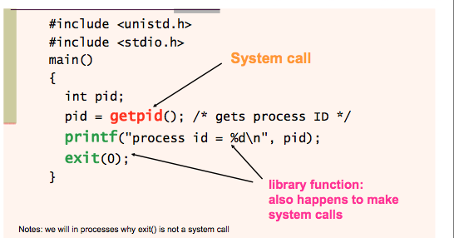
System Calls

Slide 12
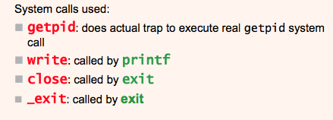
System Calls

Slide 13
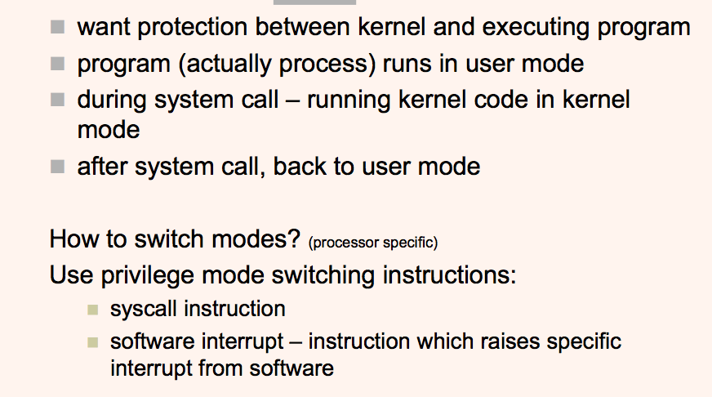
User Mode + Kernel Mode

Slide 14
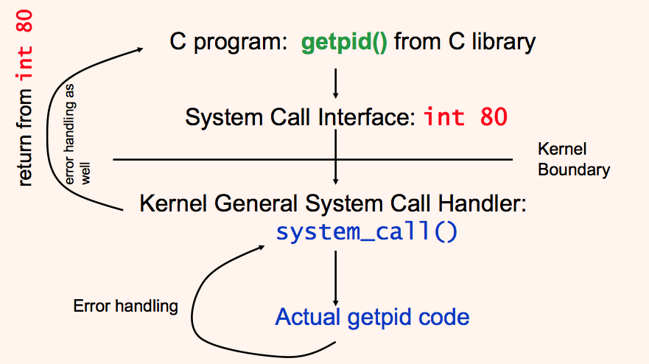
System Calls in LINUX

Slide 15
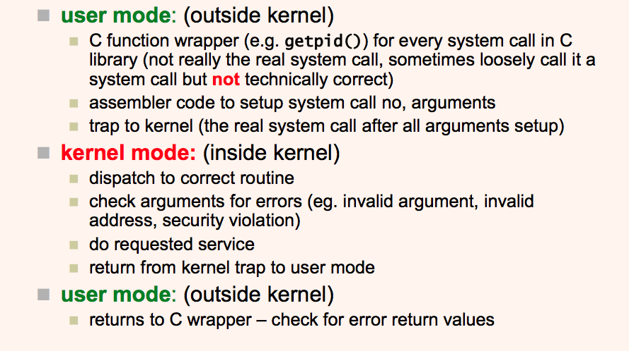
LINUX System Call

Slide 16
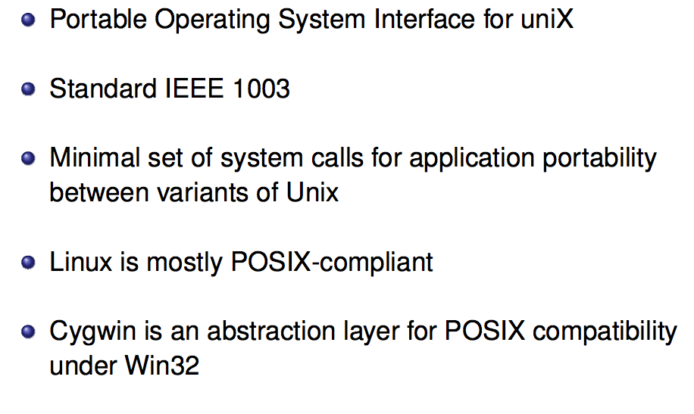
POSIX

